Slide 1
XML Schema
Paramasivam_kaliyamoorthi@gmail.com

Slide 2
JAXB
DOM
XSL (XML Style Sheet )
SAX
JAXP
XML Schema
TrAX
XPath
XML Document file extension
.xml
XPointer
.xsl
XML infoset
.xsd
XML
.dtd
XML Technologies and JAVA technologies

Slide 3
XML Coding tips
Write one code, with schema validation using SAX API, in which print every element name.
Check. The validation error comes only at the time reaching that particular element .
If it behave as expected, we can say customized error message for validation error just catching recent element name.

Slide 4
Use of XML Schema in J2EE Development
JAXP
JMS Message validation
Web Service SOAP Message definition
Configuration of any framework, application specfic configuration
Easy of XML data handling with JAXB

Slide 5
redefine
import
unique
key
keyref
Xml schema
include
all
Elements
Begin here
Attributes
choice
Built-in Type
Simple Type
Complex Type
sequence
union
12 constraints
Attribute Group
Complex Content
list
LOVE Waves among Schema components
Substitution Group
Simple content
Named Group

Slide 6
Avoid anonymouse simpleType / complexType /element definition. It is good practice and help for further update of schema file

Slide 7
Schema
SimpleType
Annotation
ComplexType
Group
attributeGroup
documentation
include
import
redefine
appinfo
element
attribute
notation

Slide 8
Kind of Reuse in XML Schema
Include – including already defined schema document or Re-Defining schema component
Ref – referencing global attribute and element group
Import – importing already defined schema document

Slide 9
Schema Element / Attribute Type
complexType
simpleType
Built-DataType
Number
String
Date
It is for
Add attribute
Add sub-element
Empty content
Mixed content
It is adding constraints for built-in type

Slide 10
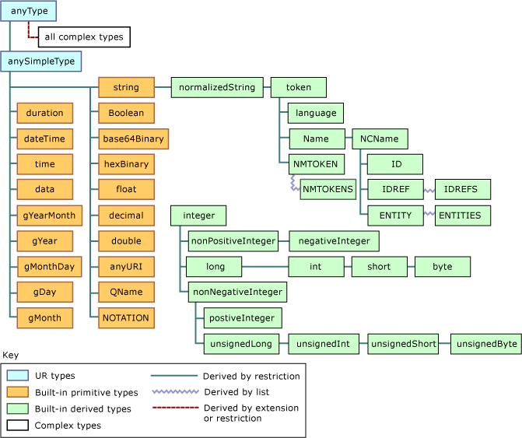
Schema built-in data type

Slide 11
Simple Type
Constraining Facets can apply to only for SimpleType by RESTICTION of built-in type
Apply Constraint to Built-in type
List & Uniton can use only with SimpleType
It can be either global or local to an element
It can use only Restriction. But not Extension

Slide 12
So, we have to use SIMPLE CONTENT only when want to EXTEND or RESTRICT exiting global SIMPLE TYPE or COMPLEX TYPE
complexType
Attribute or constraining facts related task
simpleContent
complexContent
Use COMPLEX CONTENT only want to RESTRICT or EXTEND exiting global COMPLEX TYPE alone
anyType
Attribute, nested element, empty content, mixed content related task
all
group
This is called shorthand notation. This will be implicitly
choice
sequence
attribute
These will be used to define new complex type
attributeGroup
anyAttribute

Slide 13
CAN BE LOCAL OR GLOBAL
Attribute
Element
Simple Type
Complex Type
Schema Components

Slide 14
Schema Model Group
Complex type Model Group
All
Order of element does not matter
choice
Only one of element among group
sequence
All the element occurs in specified order
Replace super class
substitutionGroup
When group of element can be used more than one place
Named Group

Slide 15
Identify Constraint
The element must exist in XML Instance
It is Xpath expression holder
key
The key sequence element is optional in XML instance doc
selector
unique
field
It is like foreign key in Database
keyref

